Slide 1
Expenses Recorder
ASP.NET Core Web App & Local SQL Server
Jia Xi Lin- 000460612

Slide 2
Project
Description
It is a simple personal expenses recording web app.
You can easily manage your expenses.
This project is created by ASP.NET Core Web App and host on local server.
All expenses data are stored into local SQL server.

Slide 3
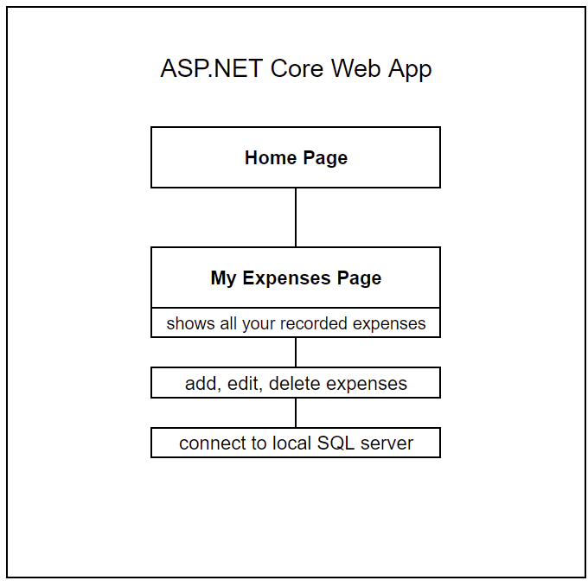
Project
Design
Project Diagram

Slide 4
Implementation
Create an ASP.NET Core Web App project
Add a data Model (Expense) with properties(Id, Description, Amount, Category and Date)
Scaffold the Expense Model - allow Create, Read, Update, and Delete (CRUD) operations
Create the initial database schema using EF's migration feature
Update the layout of the pages

Slide 5
Summary
You can use this web app to record your expenses and it is easy to manage, you can add, edit and delete your expenses it you want, all the data are connected to local SQL server.

